Slide 1
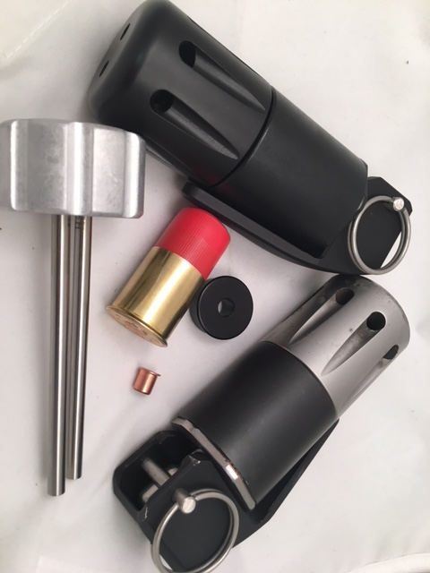
FBG-MKII and MKIII Components and Instructions

Slide 2
Weapon Name: FLASH BANG TRAINER Sound concussion Grenade 12 Gauge ( Model# FBG MkII or MkIII )
Description: The FBG is a Revolutionary Impact Detonated Flash Bang Device which creates 175dB, 4psi of over pressure and
500K CP. The FBG Flash Bang was designed to provide realistic training at a low cost per bang.
History/Background: The Impact Flash Bang was developed to overcome the shortcomings of traditional M201 Fuse type. Standard
M201 fuse type Flash Bangs have a delay of 1.5sec +/- .03 seconds, which creates uncertainty where the flashbang will detonate
(anywhere from 1.2 – 1.8 sec). The M201 fuse is also a safety concern as they are dangerous, catch items / houses on fire and the
M201 Fuse itself can become a projectile hazard.
Our Impact Flash Bang (FBG MkII or MkIII) solves all of the problem associated with traditional M201 fuse type Flash Bangs. Our Impact Flash
Bangs are not a time delay they are detonated where they strike. The operator can deploy against a Wall, Window, Slider, Car door,
Car Window, Second Story, ceiling wall couch or any other object they strike. Our FBG is not an explosive, and will never take off
like a rocket. Our FBG will not become so hot they start fires, in fact they are cool to the touch upon initiation. With the FBG you
will never have to worry about the fuse separating and injuring personnel. The FBG produces a loud bang with minimal smoke
eliminating the operational hazard associated with smoke. The most important feature of the FBG is its ability to be serviced and reloaded
by the user.
Potential Targets/Applications: Training Environments, New operator Inoculation, Individual Targets, Prison/Civil Rioters
Training, Active Shooter Training, Animal Control/Conditioning. Other Training applications
Primary Users: Law Enforcement, Military

Slide 3
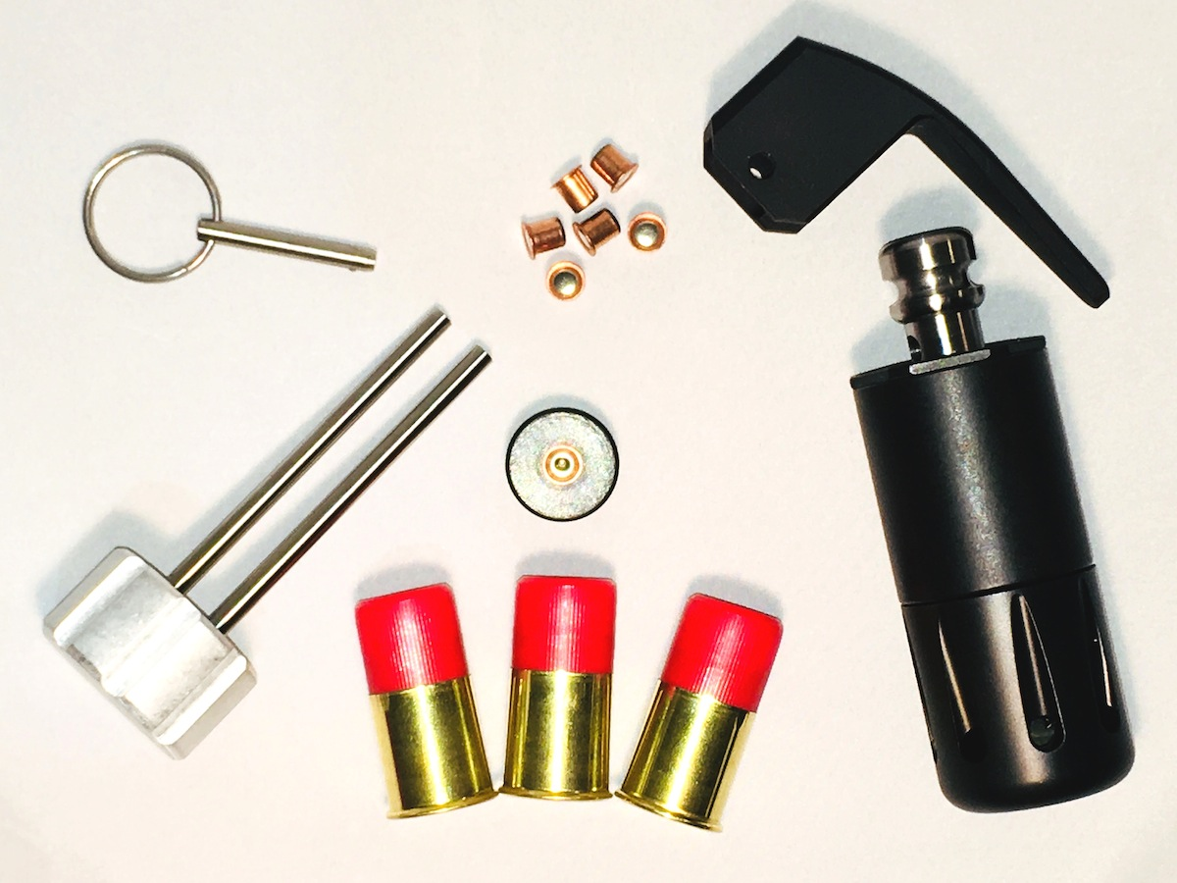
FBG-MKII and MKIII Components and Accessories
#1 Chamber
#2 Body
#3 Toggle
#4 Safety Spoon
#5 Safety Pin
#6 Extractor Tool
#7 209 Primer Adaptor
#8 FBC Cartridges
#9 209 Primers
#9
#4
#5
#3
#7
#6
#2
#1
#8

Slide 4
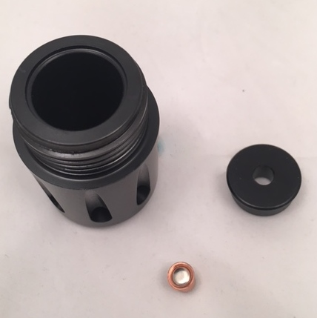
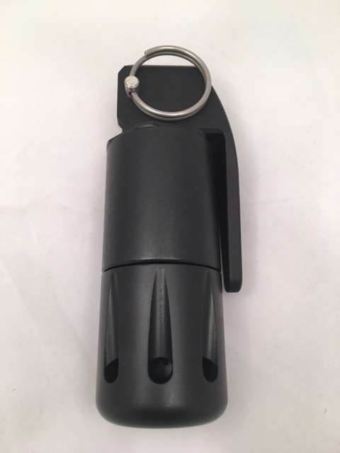
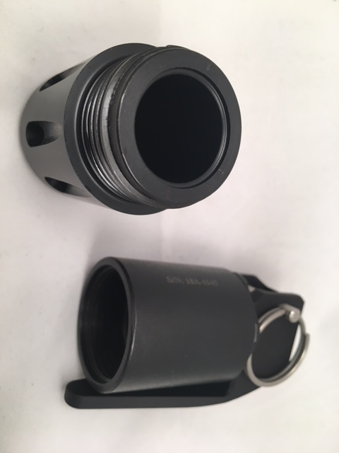
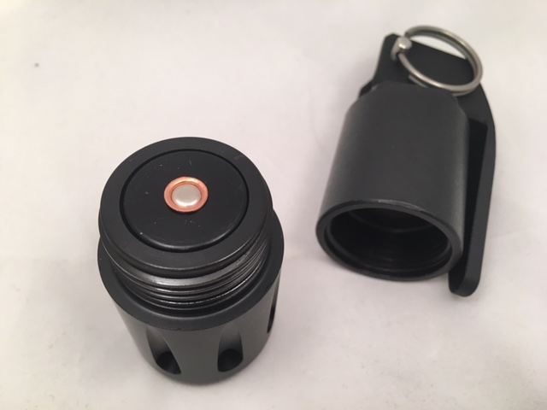
FBG-MKII and MKIII Loading Procedures
209 Primer & Adaptor
Screw Body onto Chamber insuring
The two parts mate up.
Unscrew Body from Chamber
Install Primer Adaptor and 209 Primer

Slide 5
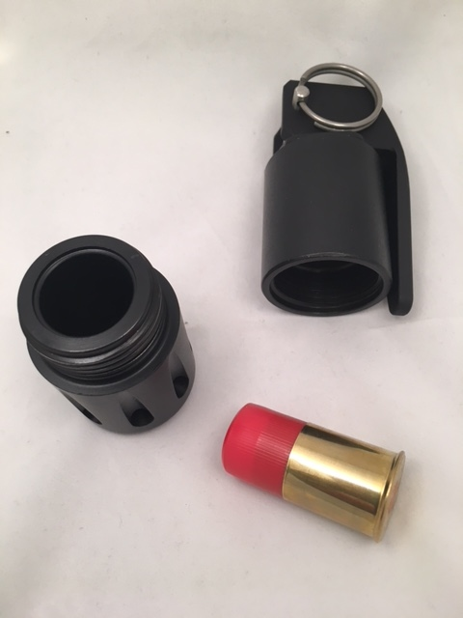
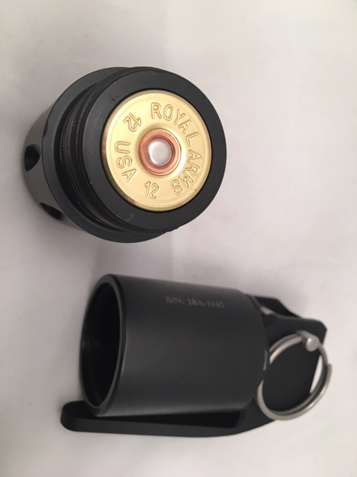
FBG-MKII and MKIII Loading Procedures
FBC Cartridge
Screw Body onto Chamber insuring
The two parts mate up.
Unscrew Body from Chamber
Place FBC Cartridge into Chamber

Slide 6
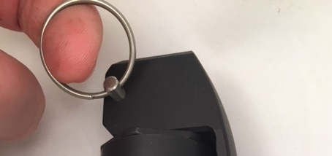
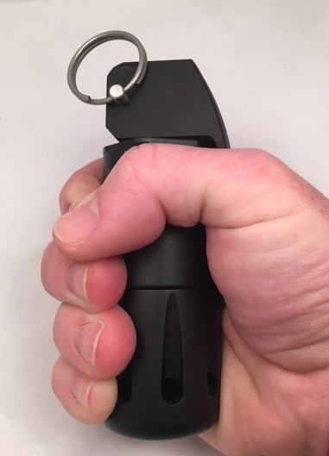
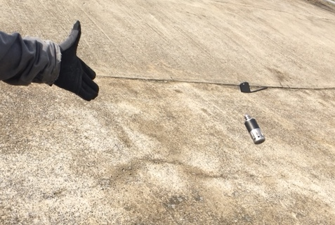
FBG-MKII and MKIII Deployment Procedures
Using other Hand Pull Safety Pin.
Insure Safety Spoon, Pin
and Cartridge are installed.
Firmly Grip FBG and Safety Spoon
In One Hand.
Deploy FlashBang in Safe Direction.

Slide 7
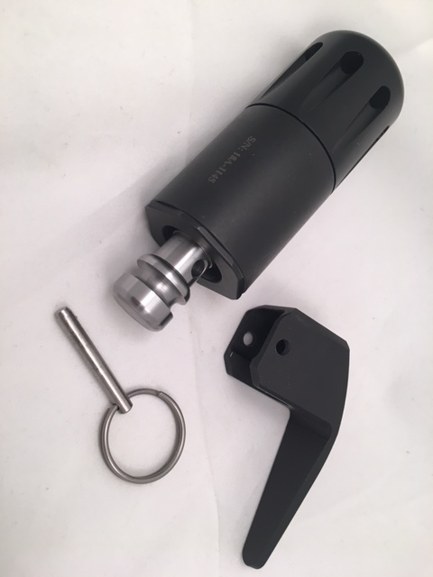
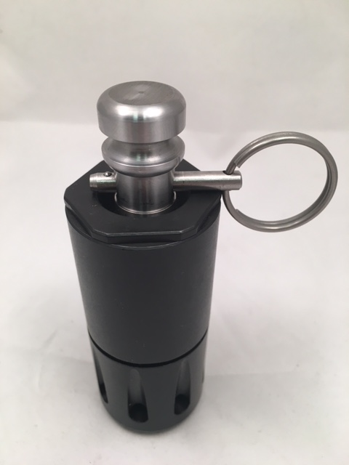
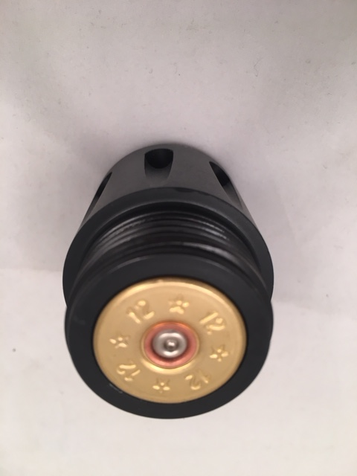
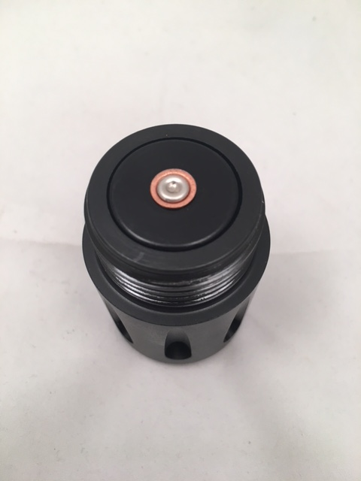
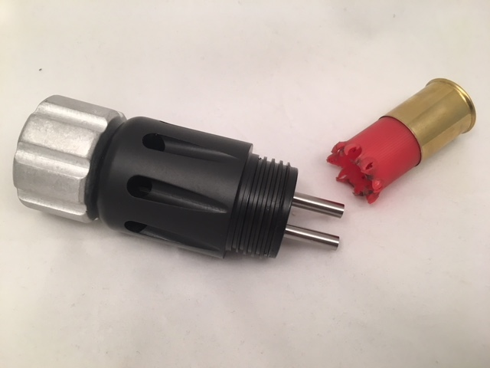
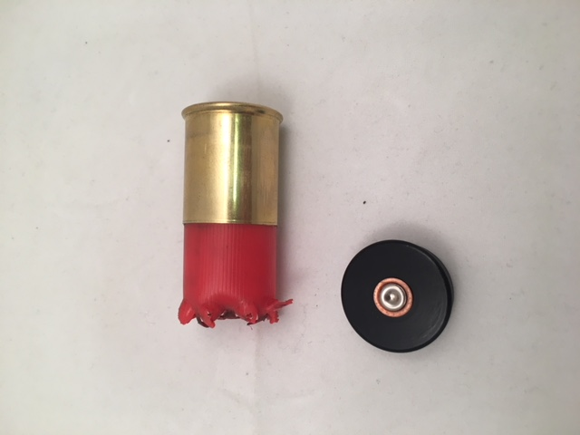
FBG-MKII and MKIII Un-Loading Procedures
Re-Install Spoon and Pin
back onto FBG.
If Spoon is lost. Install Safety
Pin through Toggle.
Recover all Parts
Inspect Primer
Use Extractor Tool to Remove
Spent Shell or Primer Adaptor.
Discard of Trash. Save Primer Adaptor.

Slide 8
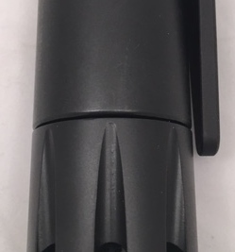
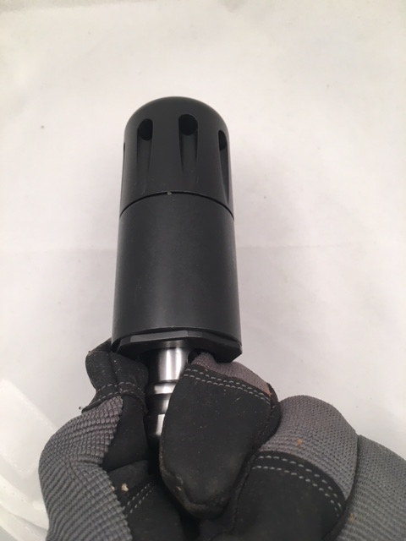
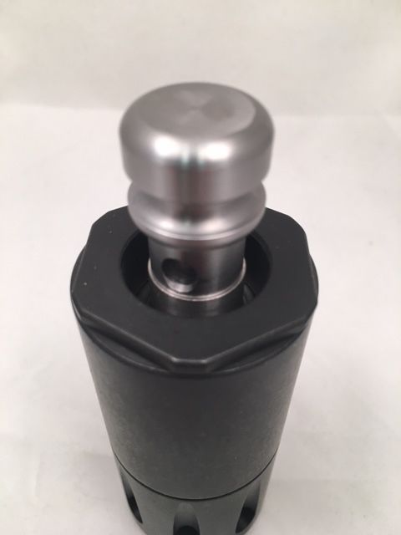
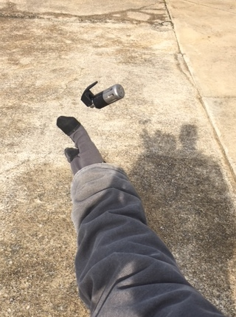
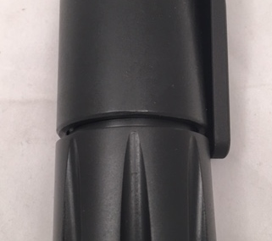
FBG-MKII and MKIII Recovery ( Failure to Fire) Procedures. Step 1
Recover devise by holding the Toggle
Or Body. Keeping Chamber side away
From operator. PPE is required.
Correct
Insure Body and Chamber
Are Fully Seated together.
Re-deploy FlashBang
In Safe Direction.
Incorrect

Slide 9
FBG-MKII and MKIII Recovery ( Failure to Fire) Procedures. Step 2
Recover devise again by holding the Toggle Or Body. Keeping Chamber side away From operator. PPE is Required.
Re-installed Safety Spoon and Safety Pin.
Insuring operators hands are away from
Chamber Side. PPE is Required.
Unscrew Body from Chamber and remove
FBC Cartridge or 209 primer.

Slide 10
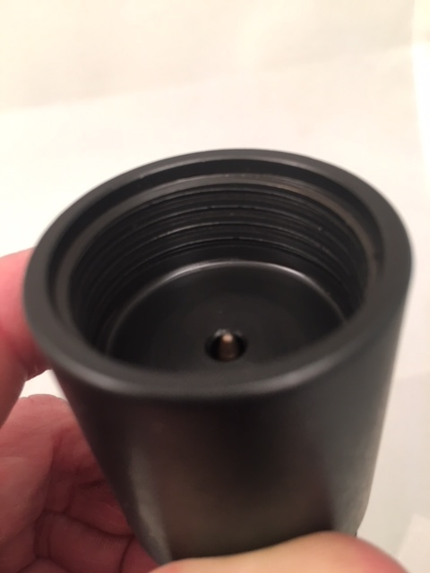
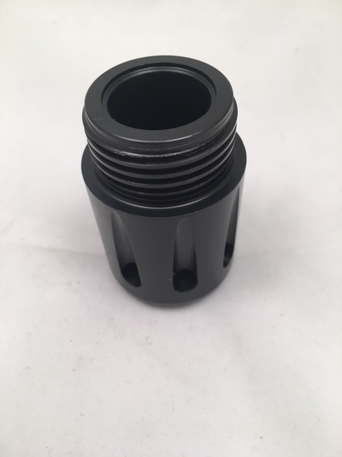
FBG-MKII and MKIII Preventative Maintenance
Clean Threads and Chamber.
Inspect for damage. Light anti-seize or oil is recommended on threads.
Clean Threads and Insure Firing
Pin moves freely. Inspect for damage.
Insure Toggle moves freely.

Slide 11
For more information please visit us on our website.
You can also follow us on Facebook, Instagram or
Watch videos of our products on YouTube.
1420 Highway 99 Lewisburg, TN 37091 • 888-876-9251 (888-8Royal1)
Website: www.RoyalArms.com • Email: Sales@RoyalArms.com

